Slide 1
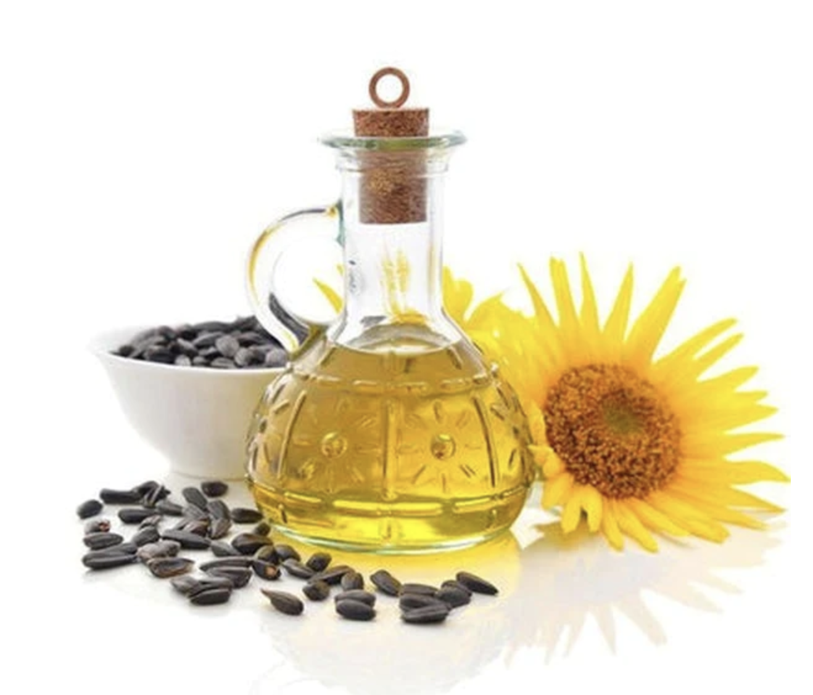
Sunflower Oil Forecasting
Keep Healthy, Keep fit.
ECON 5337-001:
Economic Forecasting
Group 3 -
Anmol Chadha
Faria Tasnim
Masrour Naderi Darbaghshahi
Zhangfan Huang

Slide 2
Agenda
01
Introduction
03
Models
02
Dataset
04
Conclusion

Slide 3
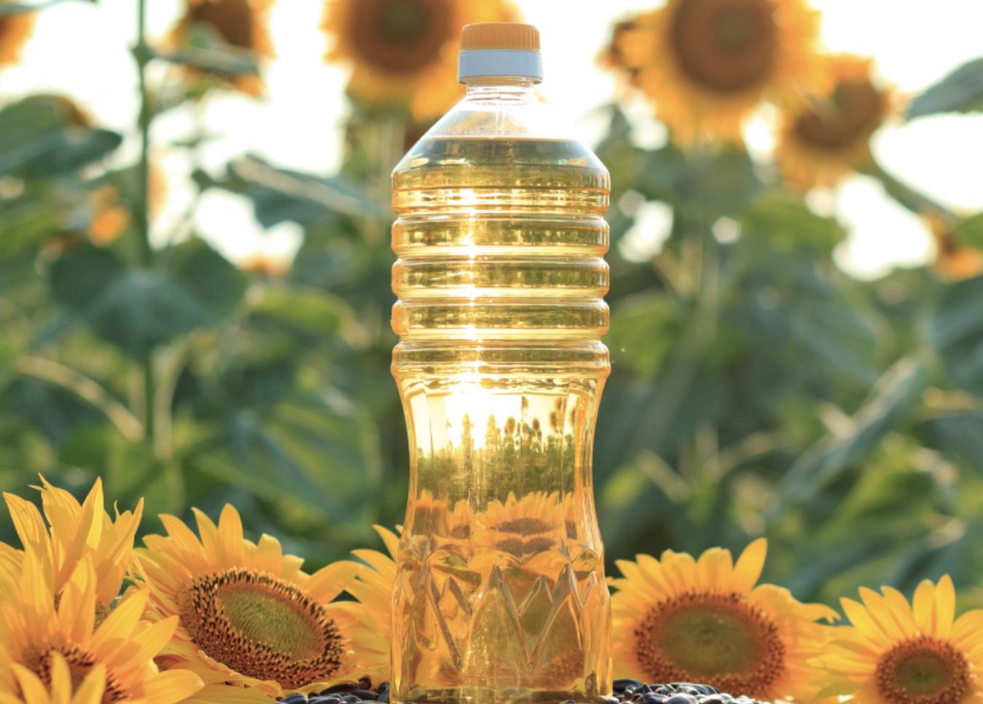

01
Introduction
Sunflower is a native crop of North and Central America widely cultivated for its seeds, flowers, and oil extraction. The oil derived from the seeds is extensively used in food, energy, and chemical industries globally.
Sunflower Oil is popular in Russia since 18th Century.
The world’s leading producer is Russia.
In 1970s ,Americans turned into sunflower oil because of its high percentage of polyunsaturated fat.
Notes:
Sunflowers are one of the few crops native to the United States. According to some sources, indigenous people likely began to cultivate them around 1000 BC. Sunflower seeds probably didn't reach Europe until the 1800s. When sunflower seeds arrived in Russia, their oil content interested farmers. The farmers selectively bred the plants until they almost doubled the oil content of the seeds.

Slide 4
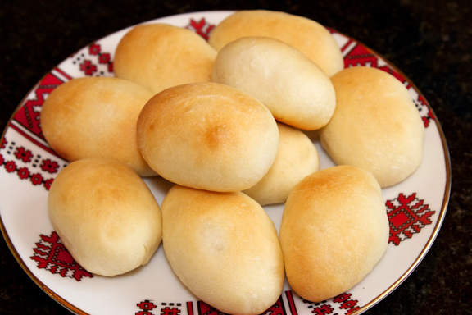
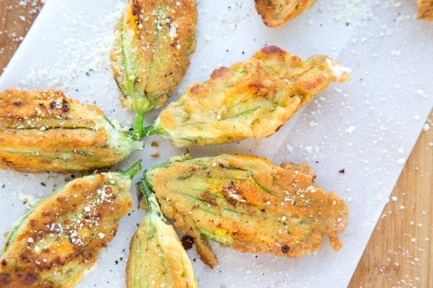
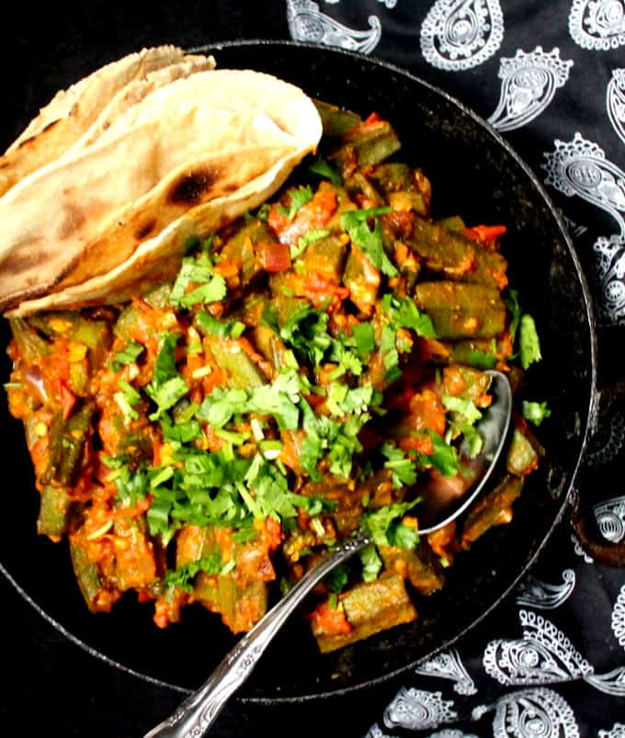
Recipe’s Made with Sunflower Oil
Indian okra curry
Pyrizhky: Ukrainian stuffed savory donuts. Use refined sunflower oil in three different ways: as a component of the milk- and yeast-based dough; for sautéing fillings such as potato and onion or chicken hearts and livers; and for shallow-frying the donuts.
Stuffed Zucchini Blossoms: Shallow-fried ricotta-stuffed blossoms in refined sunflower oil
.

Slide 5

.
Importance of Sunflower oil
Improve body health
Part of CPI Index
Sunflower oil is a good choice for keeping a healthy heart. It is rich in oleic-acid (monounsaturated fatty acid- MUFA). Moreover, it contains Vitamin E, which prevents dangerous free radicals from oxidizing the body’s cholesterol. A diet full of MUFA is beneficial to keep a check on atherosclerosis and many cardiovascular diseases can be prevented.
The CPI index is usually computed monthly, or quarterly, as a weighted average of sub-indices for different components of consumer expenditure, such as food, housing, shoes, clothing, each of which is, in turn, a weighted average of sub-sub-indices.
Indicator of the market
Nutritive Importance
The price of goods not only provide an important indicator of the balance between agricultural production and market demand, but also have strong impacts on food affordability and income.
Standard sunflower oil, like other vegetable oils, is an integral part of a healthy diet and a source of unsaturated fatty acids and liposoluble vitamins. Sunflower oil is rich in linoleic acid, which is an essential n-6 polyunsaturated fatty acid (PUFA).
Notes:
India, the third largest country in sunflower seed oil consumption, consumed approximately 2.6 million tons that year. This was almost half of what the EU-27 consumed in 2021.
The index is usually computed monthly, or quarterly in some countries, as a weighted average of sub-indices for different components of consumer expenditure, such as food, housing, shoes, clothing, each of which is, in turn, a weighted average of sub-sub-indices.

Slide 6
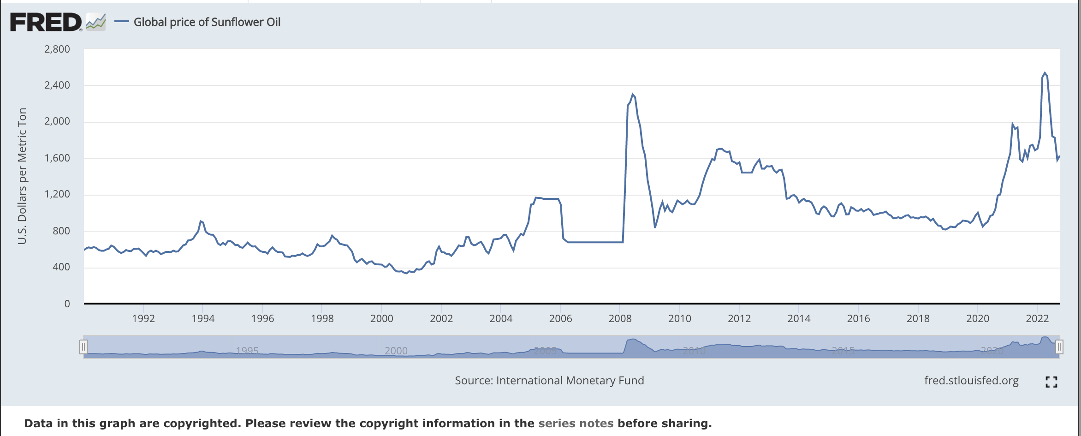
Dataset Overview
Utilized the dataset containing global price of Sunflower Oil.
Date ranges from 1/1/1990 – 9/1/2022
Units : U.S Dollars per Metric Ton and Non seasonally adjusted.
Frequency : Monthly
Columns: 2 , Rows: 393 observations
01
03
04
行业PPT模板http://www.1ppt.com/hangye/

Slide 7
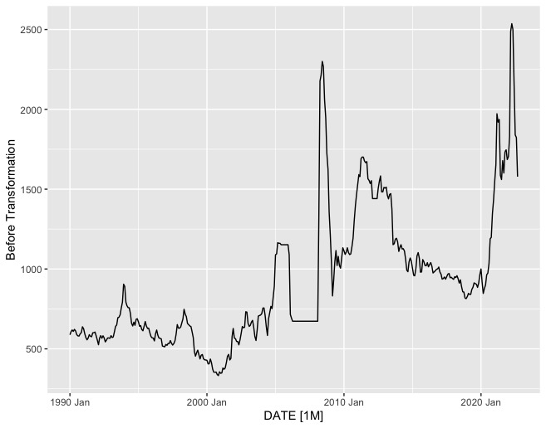
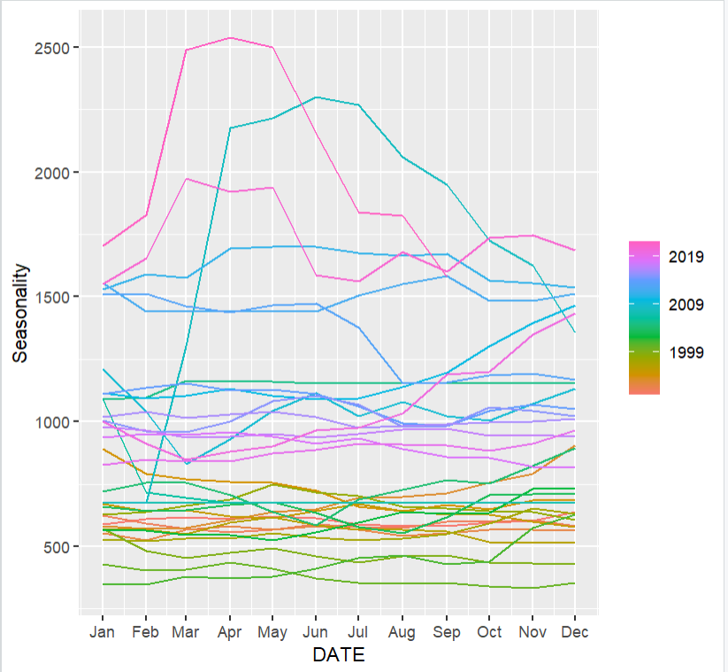
Visualizing the Raw Data-Series

Slide 8
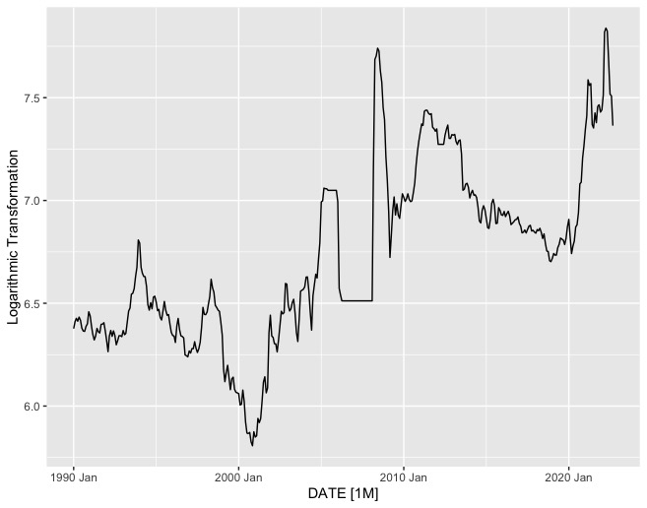
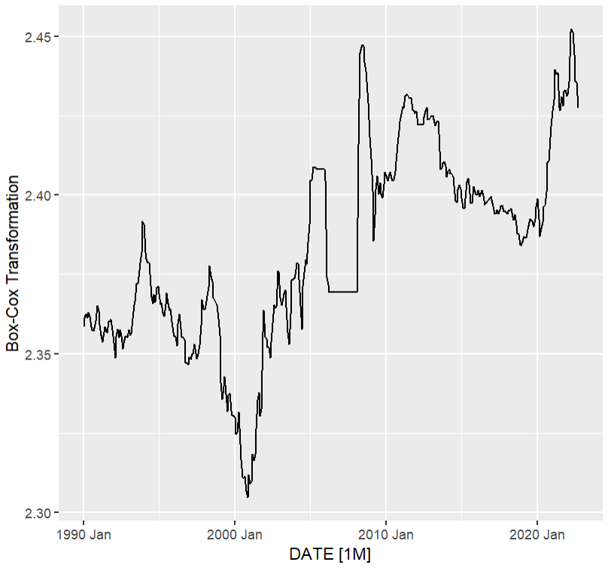
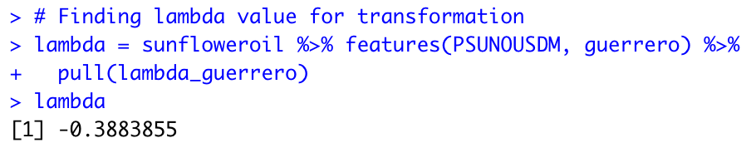
Data Transformation
Model with log Transformation(preferred)
Box-Cox Transformation
Since the lambda value is almost 0, we preferred to go with log transformation on our data series.
Notes:
I didn’t renew the graph of “Box-Cox transform.”

Slide 9
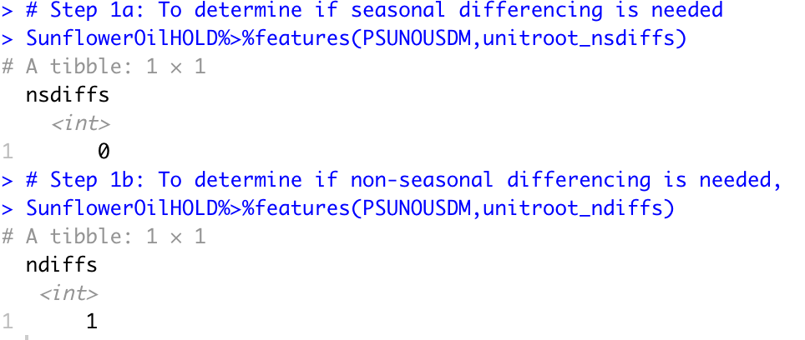
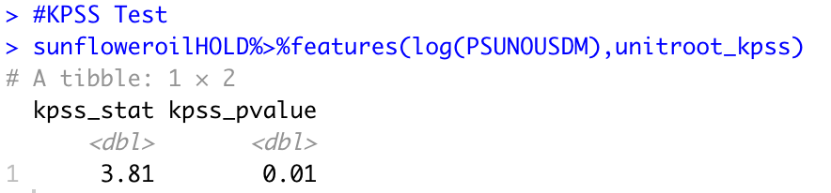
Seasonal Differencing and Non-Seasonal Differencing
Kpss Testing(Kwiatkowski-Phillips-Schmidt-Shin)

Slide 10
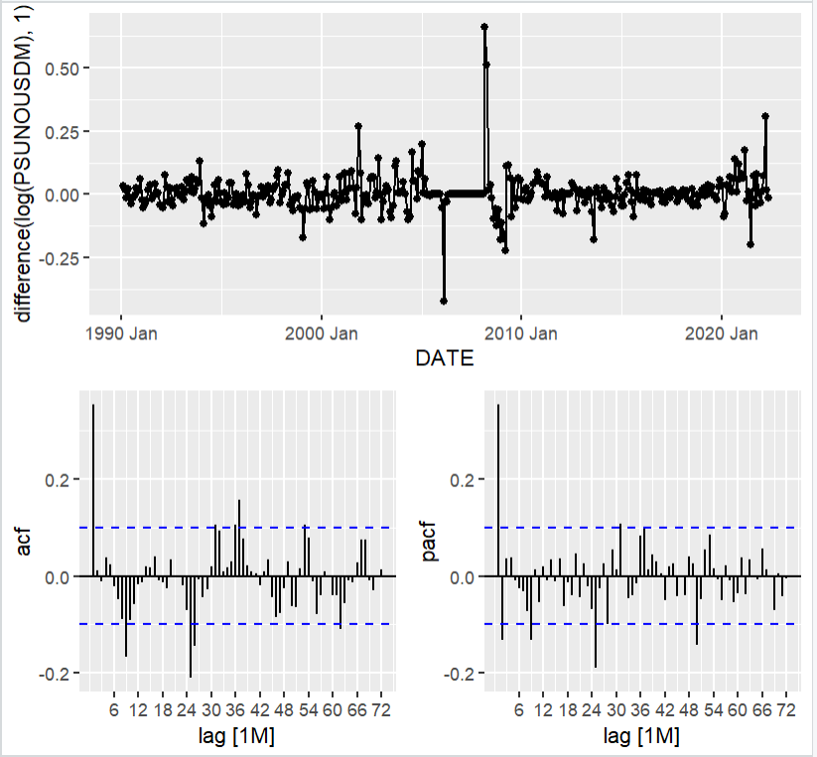
Time Series Plot: Auto-Correlation Function and Partial Auto-Correlation Function
Before Applying ARIMA Models
Performance of ARIMA Models
ARIMA | AIC | AICc | BIC
(1,1,9)(1,0,0) | -972.06 | -971.09 | -920.57
(2,1,9)(1,0,3) | -904.07 | -969.75 | -971.4
(0,1,1)(1,0,0) | -976.39 | -976.28 | -960.54
(1,1,1)(1,0,1) | -976.19 | -975.97 | -952.42
(2,1,1)(1,0,4) | -968.17 | -967.58 | -928.56
(0,1,2)(2,0,4) | -970.67 | -970.08 | -931.06

Slide 11
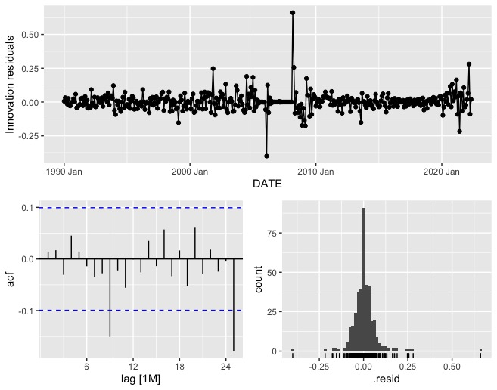

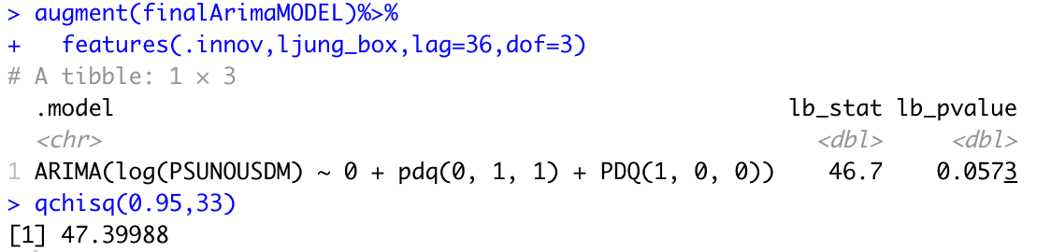
Residual Testing: Auto Correlation Function and Partial auto Correlations Function
After Applying ARIMA Model: (1,1,1)(1,0,1)
Two coefficients at lag 9 and 26 are significant.
Coefficients lie inside 95% confidence bands are statistically insignificant.
Diagnostics Testing
Based on a 5% test-size, our test statistics value (46.7)< critical value(47.4), so we fail to reject the
null hypothesis which means that there is only modest evidence of residual correlation.

Slide 12
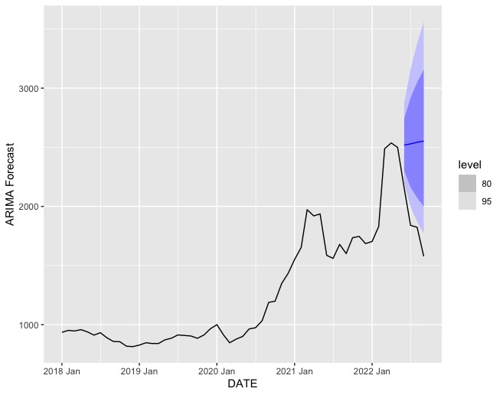
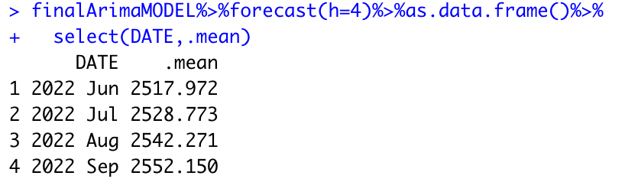
Forecasting Using Best ARIMA Model
Mean Forecasted Values(ARIMA)

Slide 13
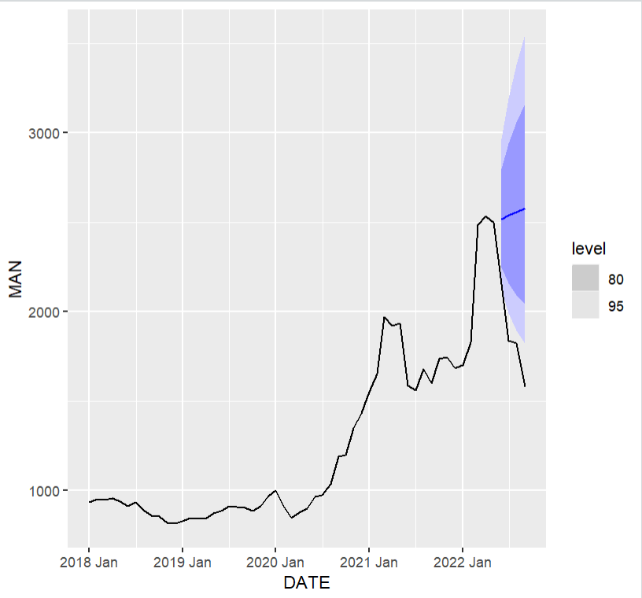
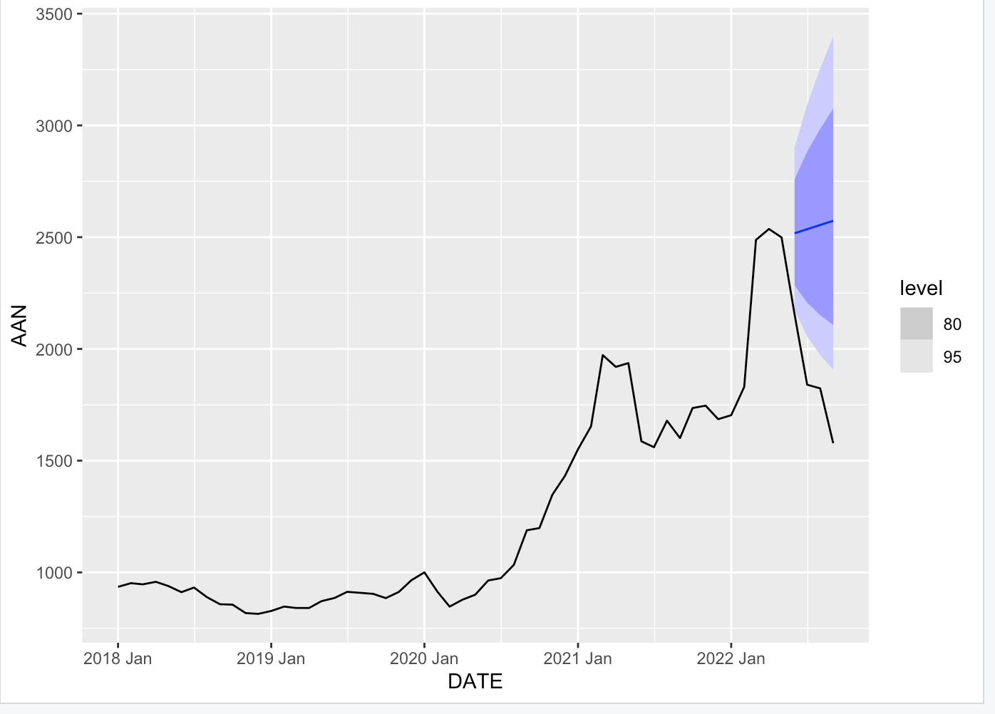
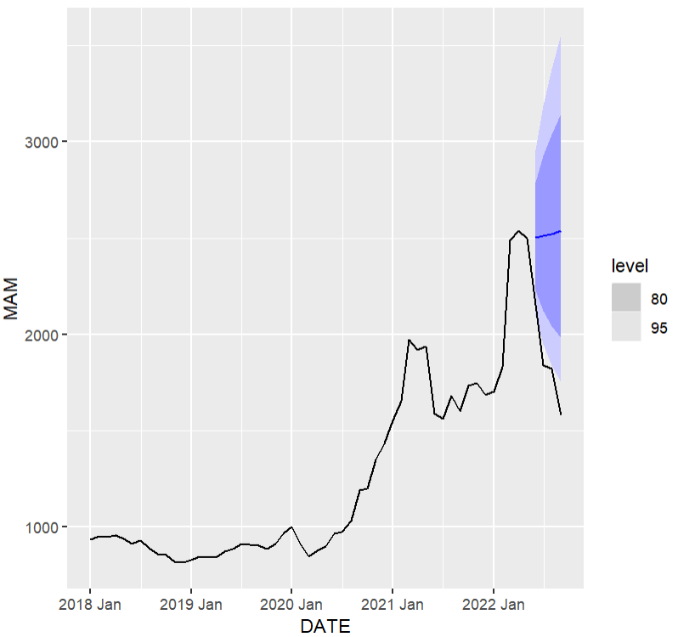
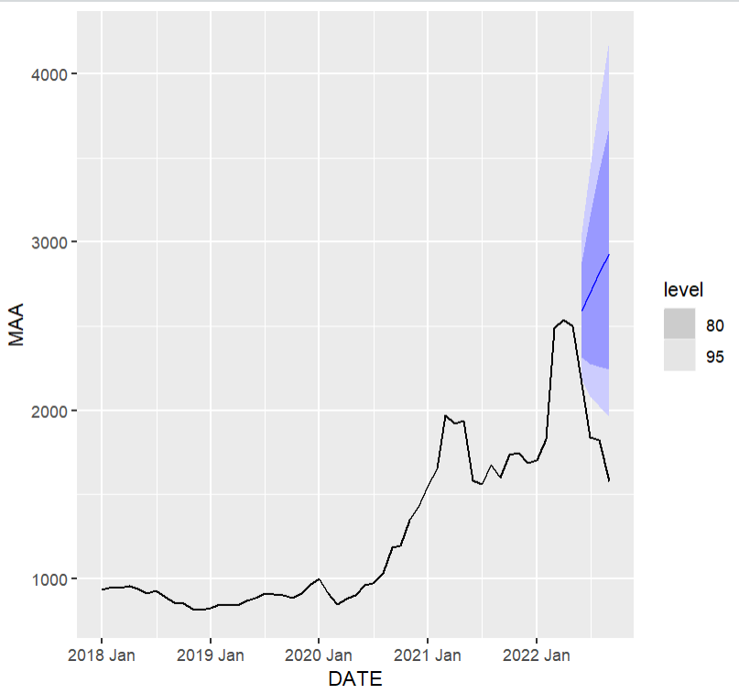
Different ETS Models

Slide 14
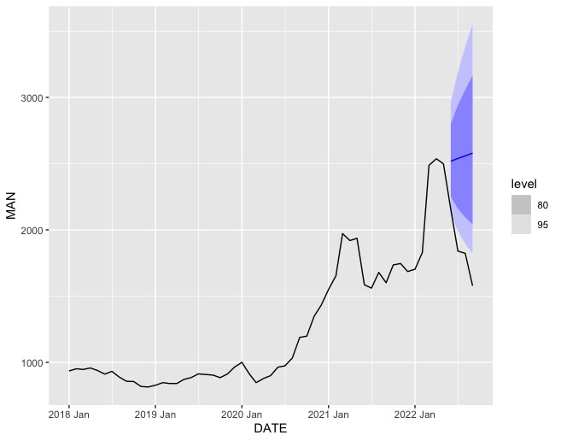
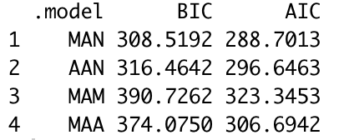
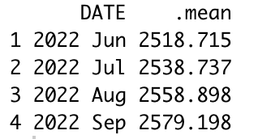
Forecasting Using Best ETS Model
Performance of ETS Models
Mean Forecasted Values(ETS)

Slide 15
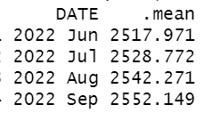
Comparison between Two Models
Model | RMSE
ETS - “M” “A” “N” | 735.51
ARIMA – pdq(0,1,1) PDQ(1,0,0) | 719.71
Mean Forecasted Values(ARIMA)
Mean Forecasted Values(ETS)
ARIMA Model has lowest RMSE, so our best model is ARIMA-pdq(0,1,1) PDQ(1,0,0).

Slide 16
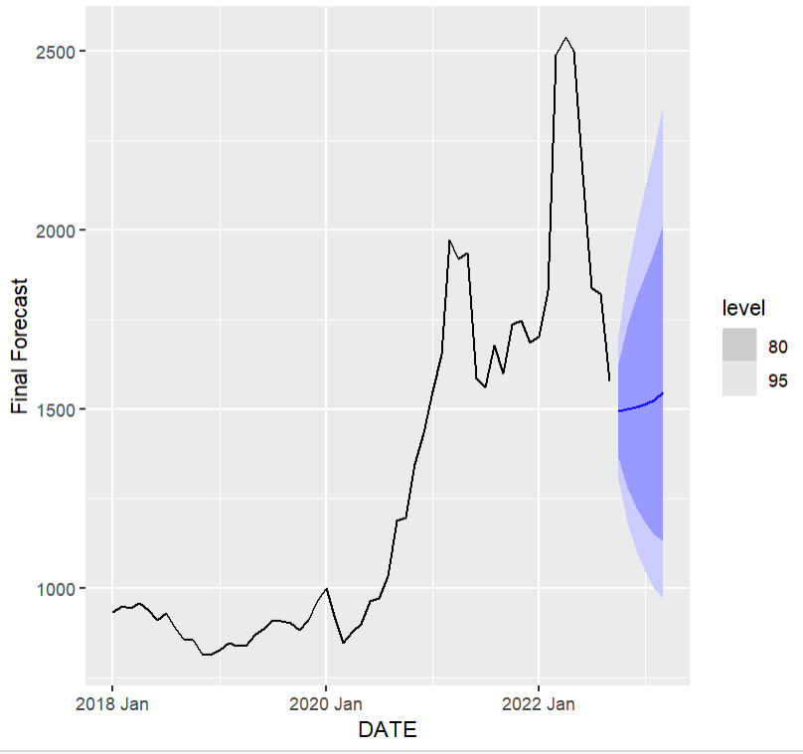
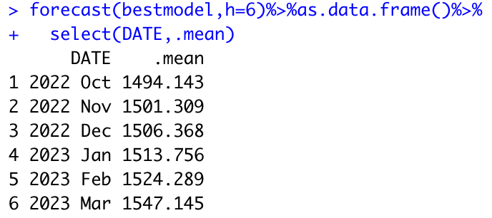
Final Model (ARIMA): 6 Step Ahead Forecasting

Slide 17
Thank you!
Any Questions???

